Slide 1
Course Contents
Sungjoon Choi
(sungjoon.choi@cpslab.snu.ac.kr)

Slide 2
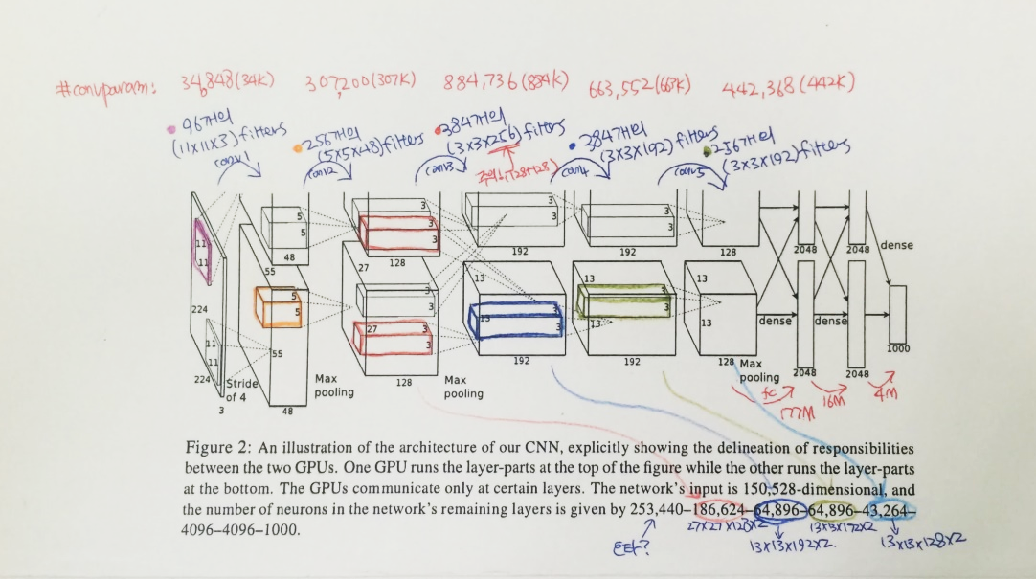
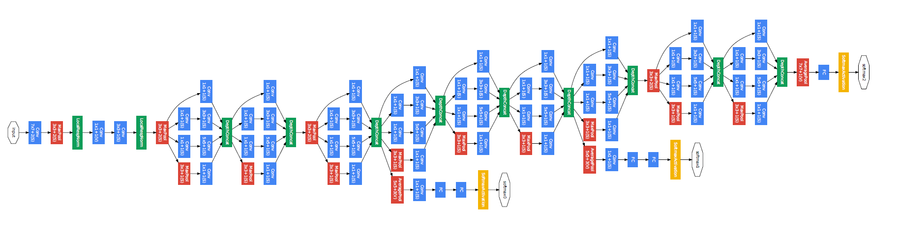
Convolutional neural network
AlexNet
GoogleLeNet

Slide 3
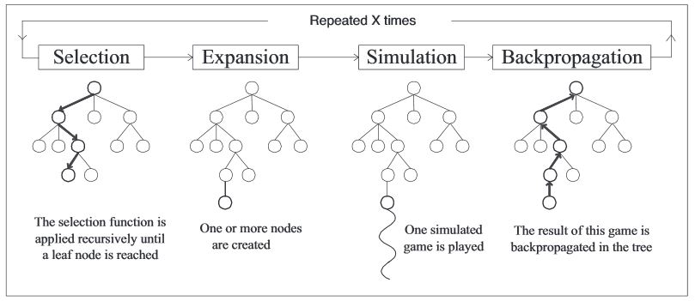
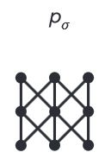
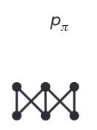
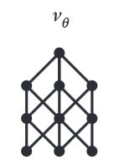
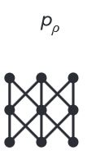
Algorithms behind AlphaGo
Rollout net
Value net
RL net
SL Policy Network

Slide 4

Regularization
Main purpose is to avoid “OverFitting”

Slide 5


Optimization Methods

Slide 6
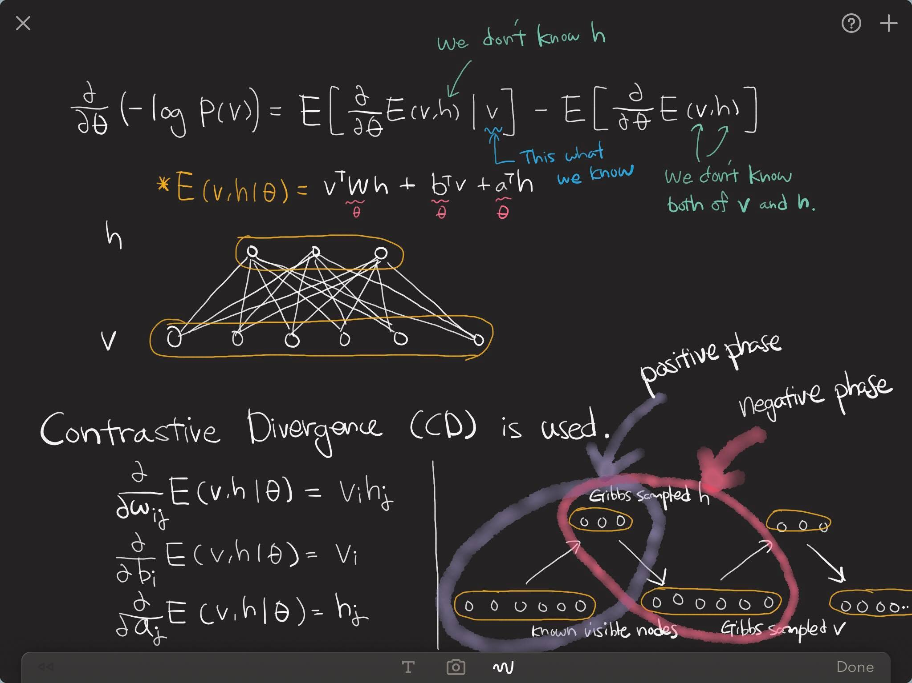
Restricted Boltzmann machine

Slide 7
Denoising Auto-Encoder

Slide 8
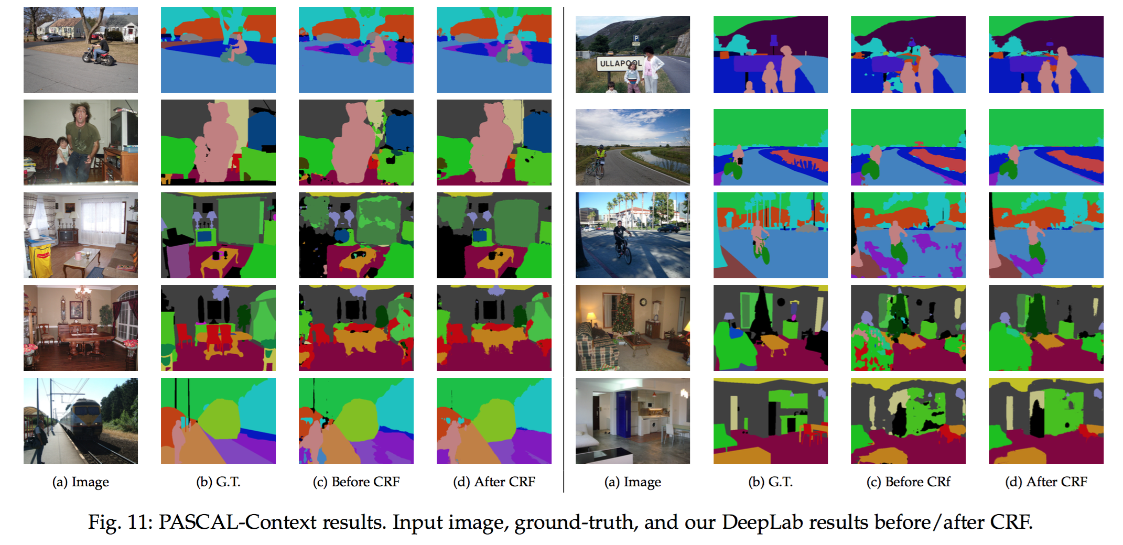
Semantic Segmentation

Slide 9
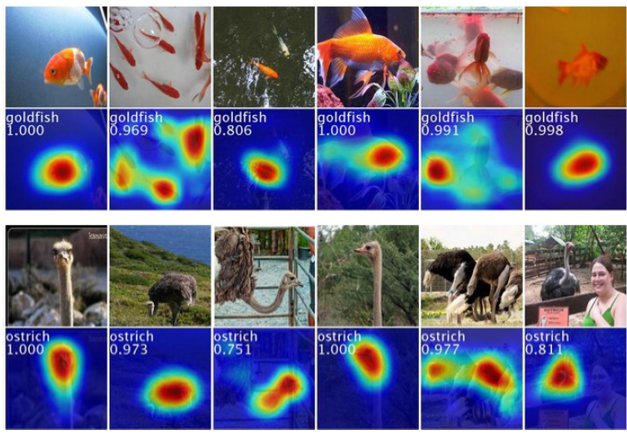
Weakly-Supervised Localization

Slide 10
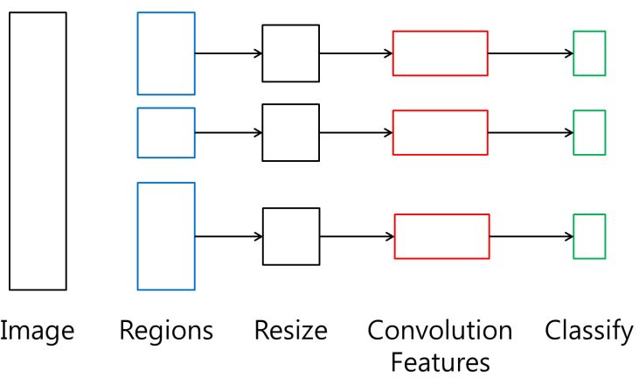
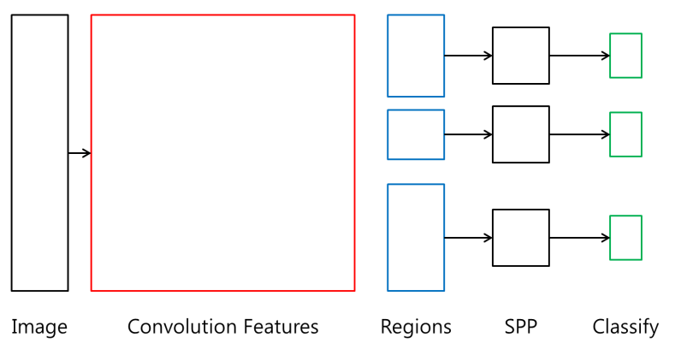
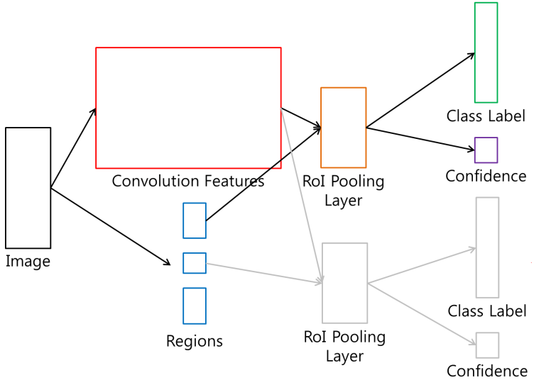
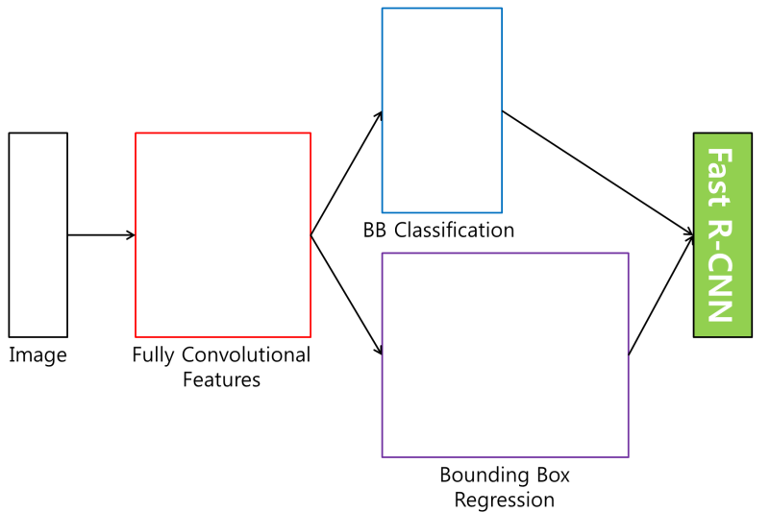
Detection Methods
R-CNN
SPP net
Fast R-CNN
Faster R-CNN

Slide 11

RNN - LSTM
Output
Forget Gate
(Cell) state
Next (Cell) State
Input Gate
Output Gate
Hidden State
Next Hidden State
Input
Output = Hidden state
11
http://colah.github.io/posts/2015-08-Understanding-LSTMs/

Slide 12
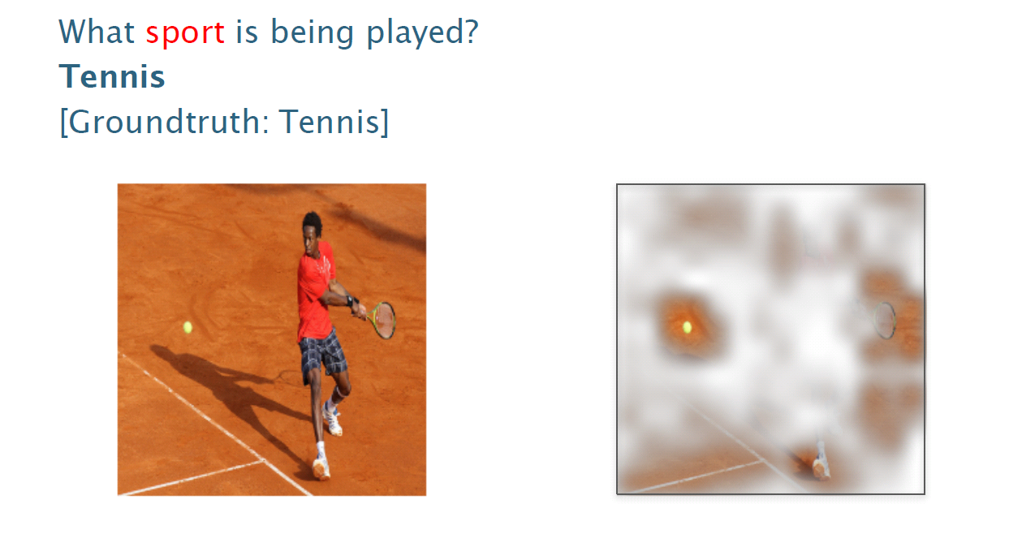
Visual Q&A

Slide 13
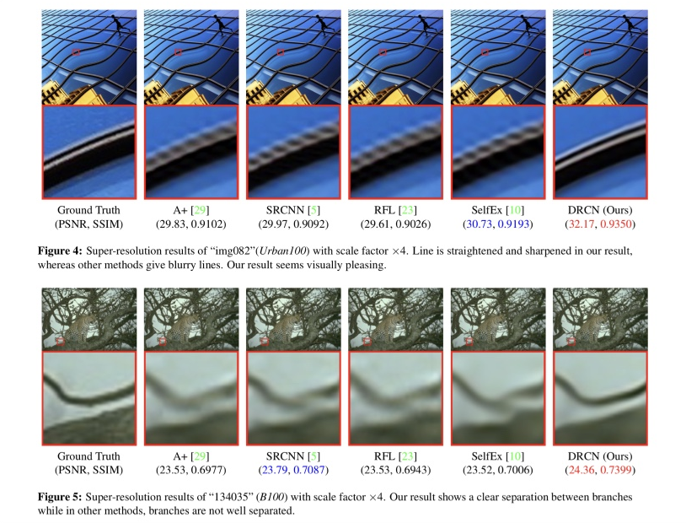
Super Resolution (optional)

Slide 14
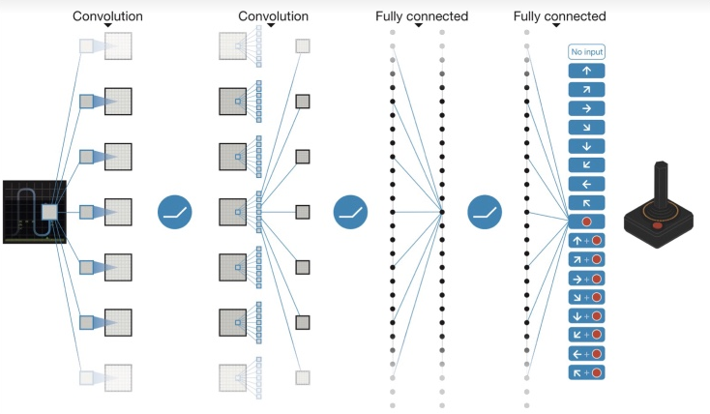
Deep Reinforcement Learning

Slide 15
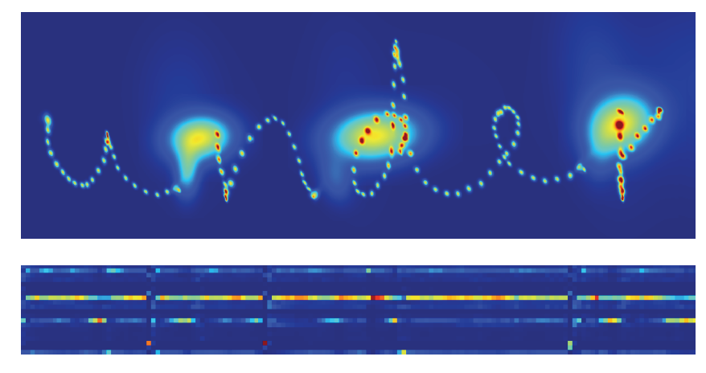
Sequence Generation

Slide 16
Word Embedding

Slide 17
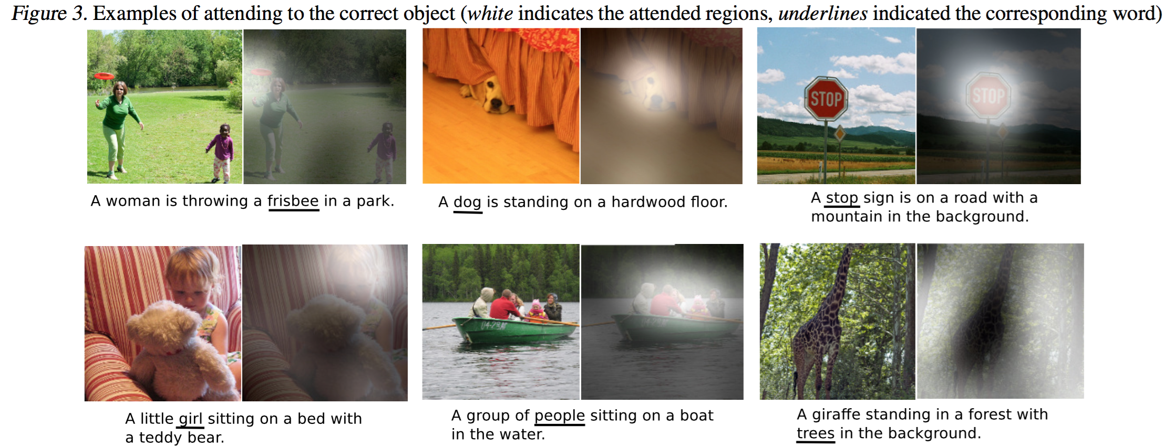
Image Captioning

Slide 18
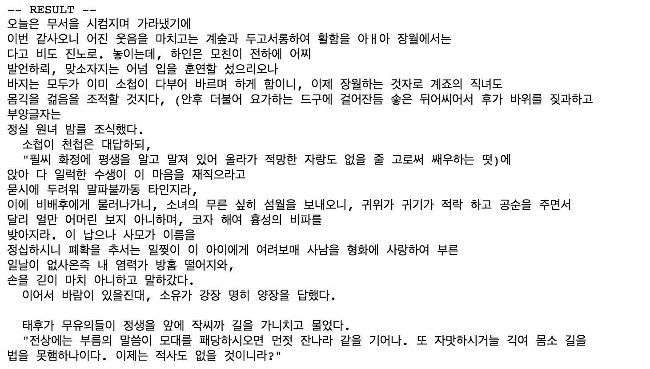
Hangul-RNN (optional)

Slide 19
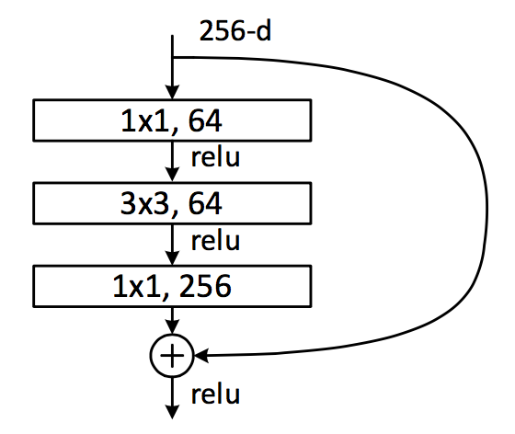
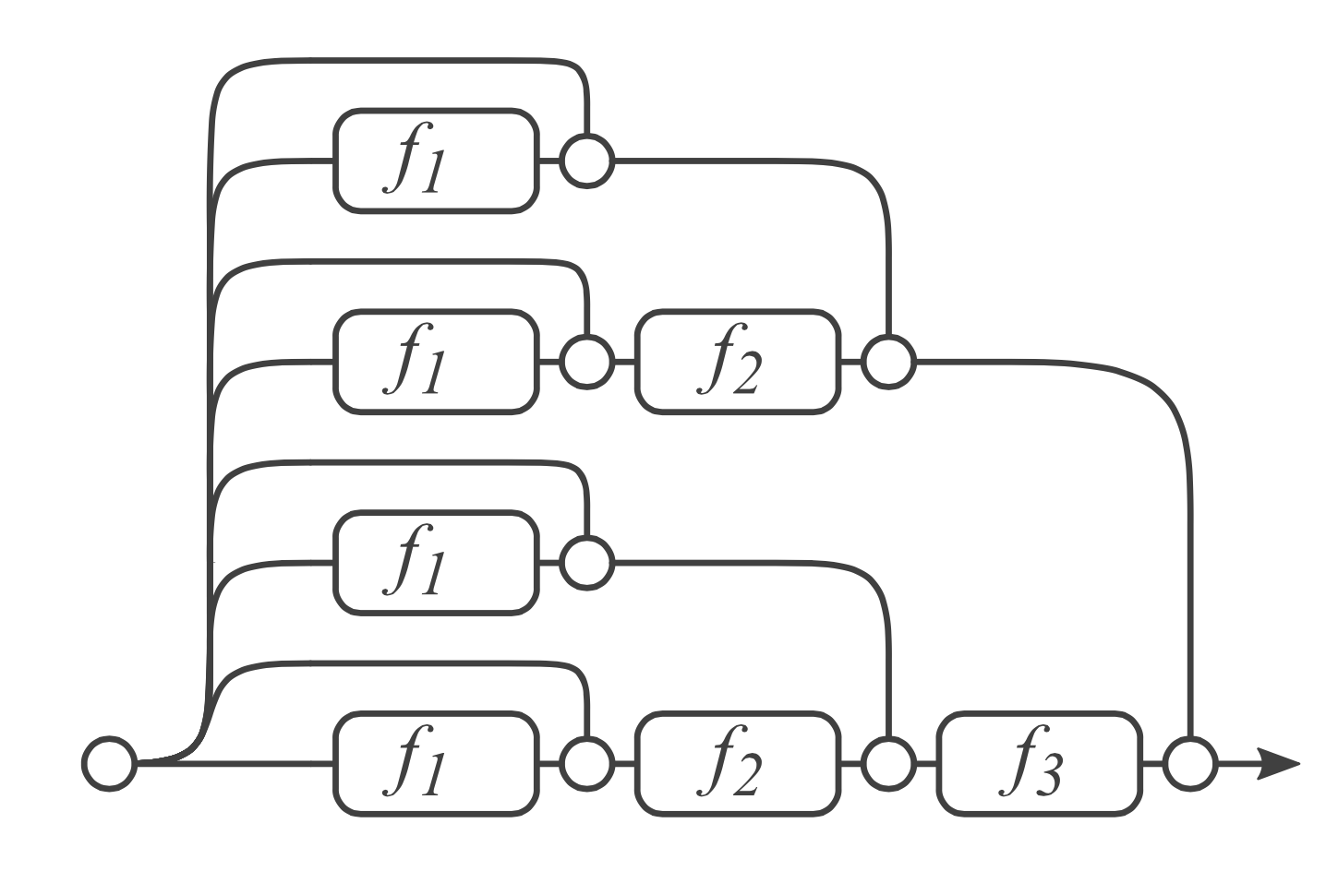
Residual Network & Analyses
Dimension reduction
Convolution
Dimension increasement

Slide 20
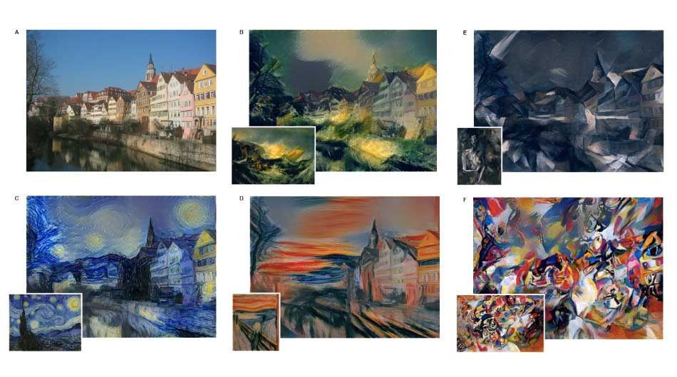
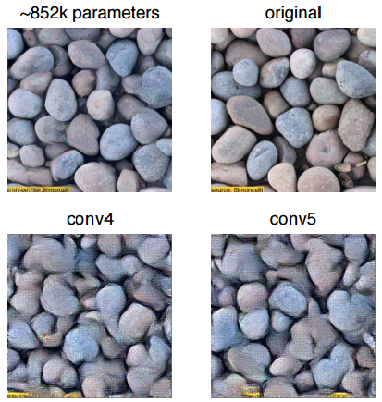
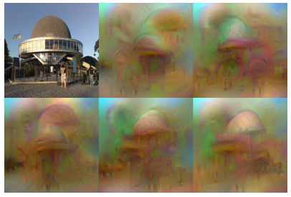
Neural Style (optional)
Texture Synthesis Using Convolutional Neural Networks
NIPS2015
Understanding Deep Image Representations by Inverting Them
CVPR2015

Slide 21
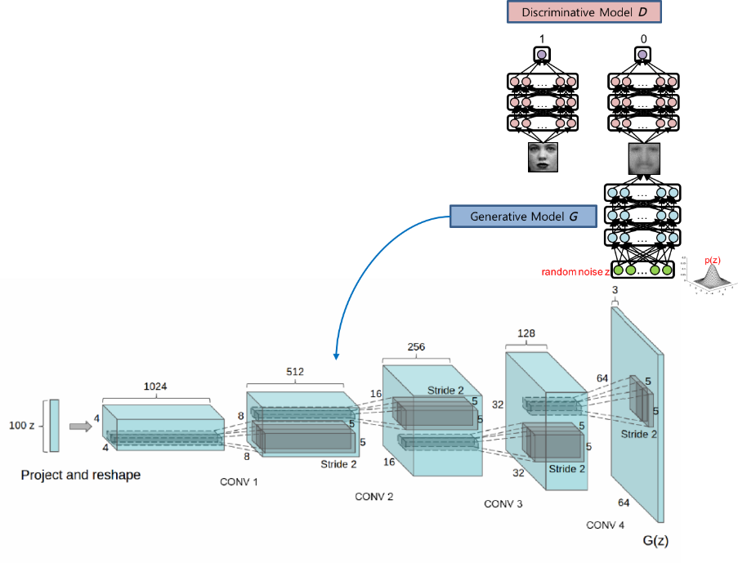
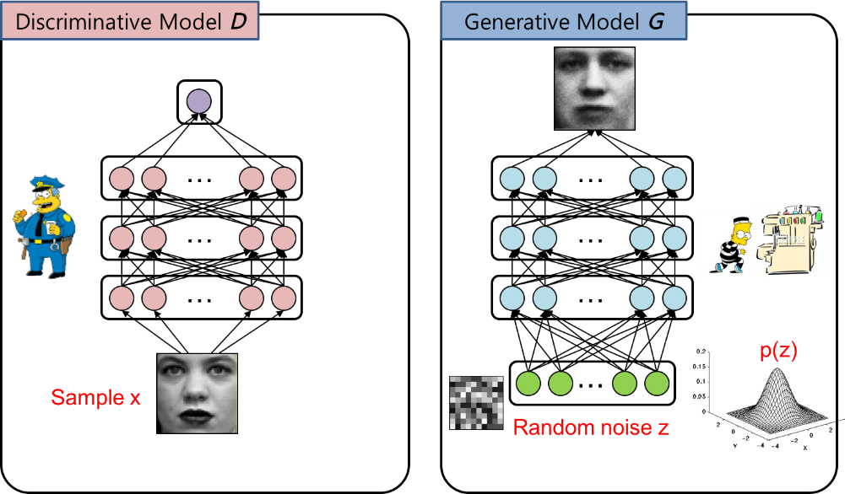
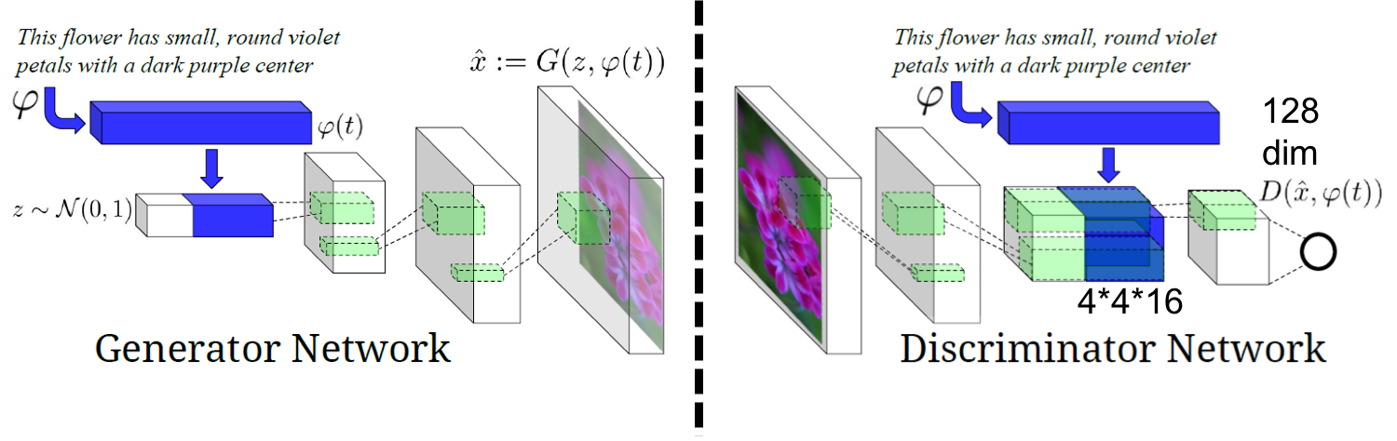
Generative Adversarial Networks

Slide 22
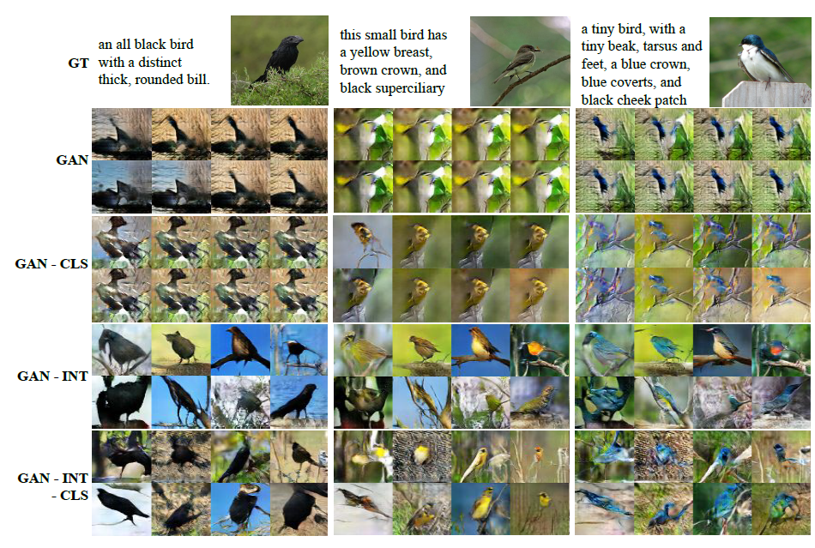
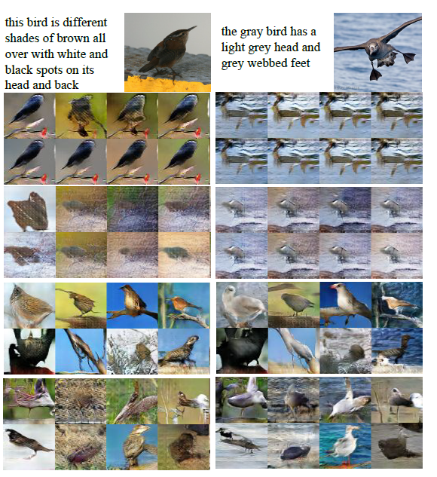
GAN Series

Slide 23
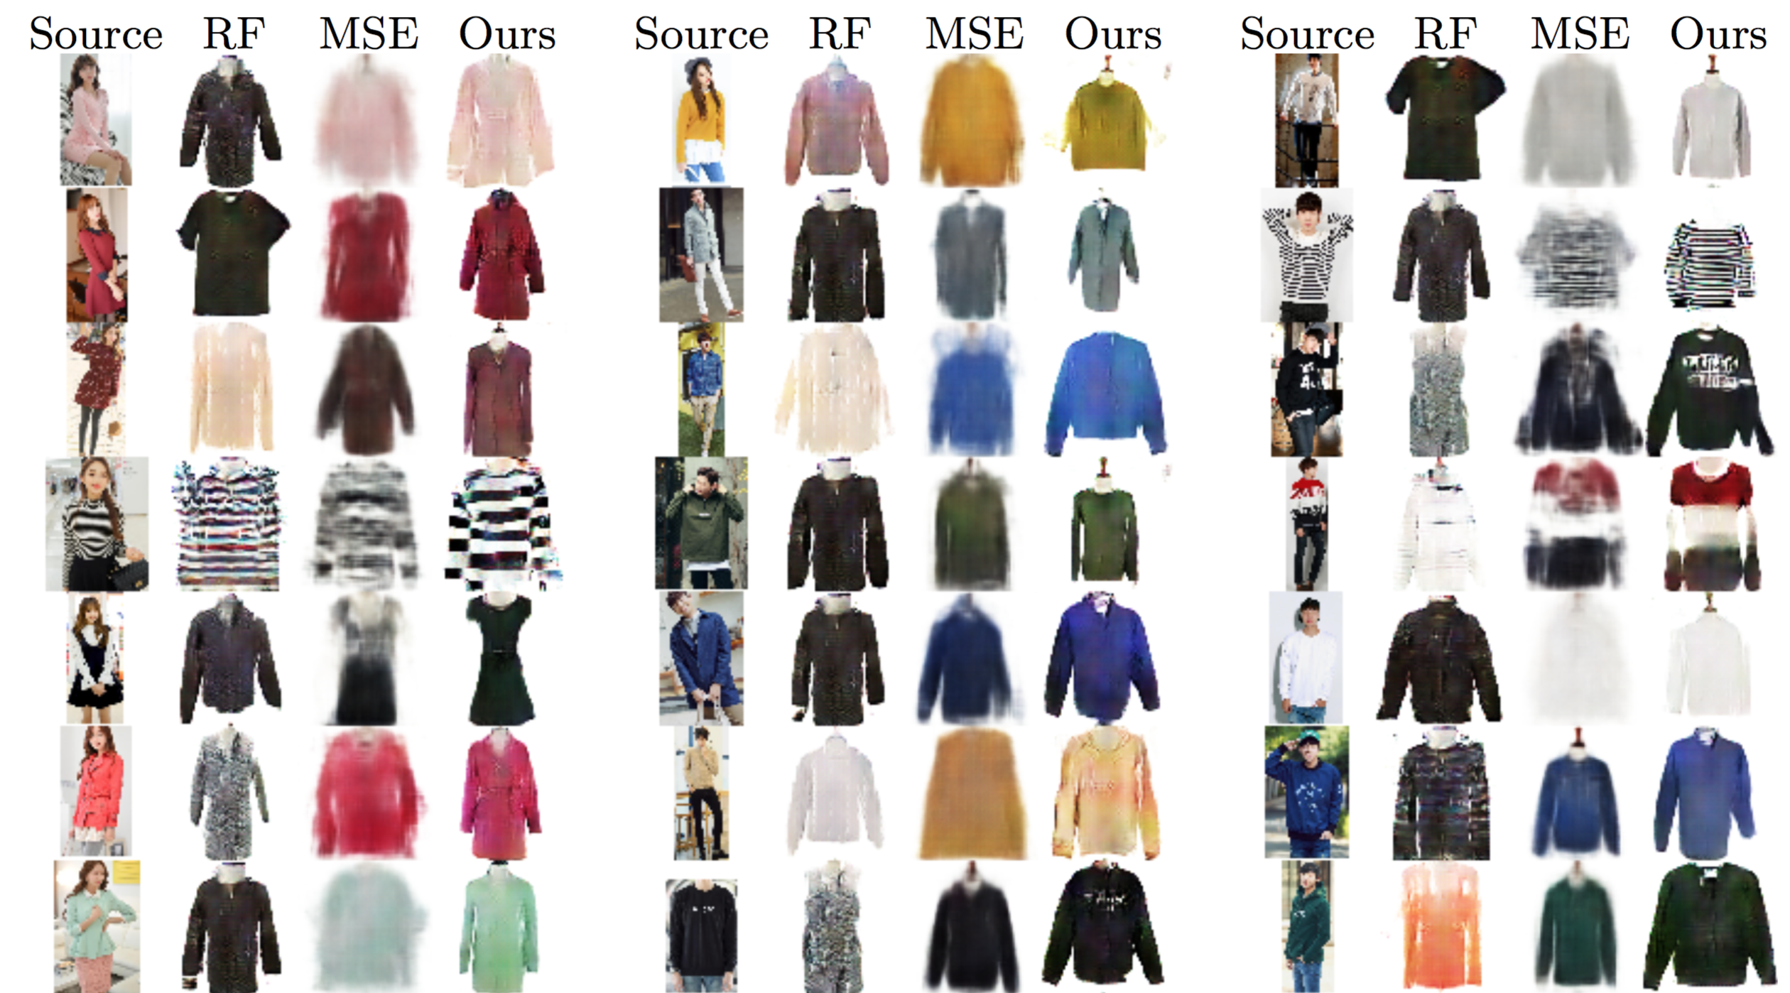
GAN Series

Slide 24
+ Alpha

